Slide 1
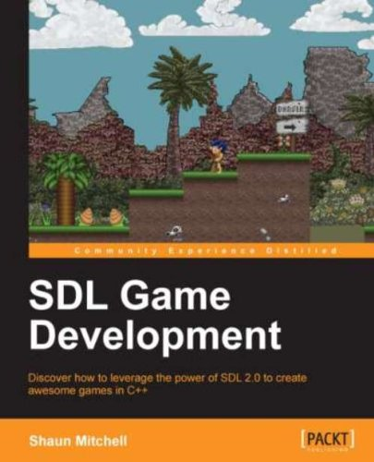
SDL Game Development

Slide 2
Github Code
https://github.com/caiotava/SDLBook
AlienAttack-master.zip
https://github.com/antonkanin/AlienAttack
AlienAttack-master.zip

